Slide 1
Drought Legacies and Implications for Soil Microbiome Resilience
Bin Wang
Ecology and Evolutionary Biology
University of California Irvine

Slide 2
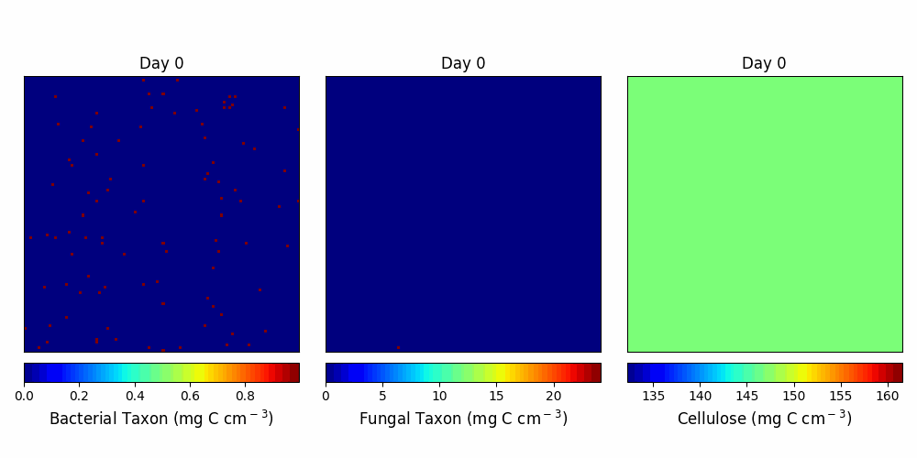

Slide 3
A
B
default
C
D
dispersal
E

Slide 4
Year-6
Year-9
A
B
default
C
D
dispersal

Slide 5
A
B
default
C
D
dispersal

Slide 6
A
default
B
C
dispersal
D

Slide 7
default
dispersal
A
C
B
D

Slide 8
A
B
C
D

Slide 9
Drought legacy-driven microbiome trajectories on the 2-D space
No legacy
?
Enzyme Investment
Transient legacy
Persistent legacy
Drought tolerance

Slide 10
S
?
Persistent legacy
Transient legacy
No legacy
Y
A

Slide 11
S
Y
A

Slide 12
Version 1

Slide 13
Community Dynamics

Slide 14
Community-level Drought Tolerance and Enzyme Investment

Slide 15
Tradeoff between Enzyme Investment and Yield
Year 6
Year 9

Slide 16
Dispersal

Slide 17
Tradeoff between Enzyme Investment and Yield
Year 6
Year 9

Slide 18
Drought legacy in litter decomposition

